Slide 1
Forecasting Tata Motors Stock Prices using Time Series Analysis By
Amresh Kumar- 9852524372
Sneha Tulasigeri- 7892797410
Mr. Sharath S- 9738107210
Miss. MANASA N- 8431619328
Mr. Rajath H S- 9742026760
Under the Guidance of
Aishwarya

Slide 2
Agenda
Abstract
Introduction
Methods
Selected Methods
Implementation
Result and Discussion
Conclusion

Slide 3
Abstract
Time series forecasting has been widely used to determine the future prices of stock, and the analysis and modelling of finance time series importantly guide investors’ decisions and trades.
this work proposes an intelligent time series prediction system that uses sliding-window metaheuristic optimization for the purpose of predicting the stock prices of multiple companies taken at random.
The system has a graphical user interface and functions as a stand-alone application.
The proposed model is a promising predictive technique for highly non-linear time series, whose patterns are difficult to capture by traditional models.

Slide 4
Introduction
Financial markets are highly volatile and generate huge amounts of data daily. Investment is a commitment of money or other resources to obtain benefits in the future.
Stock is one type of securities. It is the most popular financial market instrument and its value changes quickly. It can be defined as a sign of capital participation by a person or an enterprise in a company or a limited liability company. The stock market provides opportunities for brokers and companies to make investments on neutral ground.
Stock prices are predicted to determine the future value of companies’ stock or other financial instruments that are marketed on financial exchanges. However, the stock market is characterized by nonlinearities, discontinuities, and high-frequency multi-polynomial components because it interacts with many factors such as political events, general economic conditions, and traders’ expectations. Therefore, making precise predictions of stock values are challenging [

Slide 5
What is Machine Learning?
Machine learning (ML) is the science of creating algorithms and statistical models that computers use to perform tasks without explicit instructions.
ML algorithms process large amounts of historical data and identify data patterns.

Slide 6
Machine Learning in Stock Prediction
Stock prices aren’t just randomly generated numbers. So, they can be analyzed as a sequence of discrete-time data; in other words, time-series observations taken at successive points in time (usually on a daily basis). Time series forecasting (predicting future values based on historical values) applies well to stock forecasting.
Because of the sequential nature of time-series data, we need a way to aggregate this sequence of information. From all the potential techniques, the most intuitive one is MA with the ability to smooth out short-term fluctuations.

Slide 7
Steps Follwed
Data Collection
Importing Data
Data Cleaning
Data Visualization
Making Data Stationary
Dividing Data into Train And test
Model Building
Future Prediction
Conclusion
Summary

Slide 8
Data Collection
We gather the data of Tata Motors stock price from a website called Yahoo financing
Link- Tata Motors Limited (TATAMOTORS.NS) Stock Historical Prices & Data - Yahoo Finance
Data has different row and coloums
Each rows represent the stock price of each day from January 2003 to 17th November 2023
It has different columns like Data, Open, High, Low, Close, Adj Close and Volume.

Slide 9
Date- Date wise detail of the stock price.
Open- Opening price of stock on that day.
High-The Highest price of the stock on that day.
Low- The Lowest price of the stock on that day.
Close- The Closingprice of the stock on that day.
Adj Close- The adjusted closing price on particular day.
Volume- Volume is the amount of an asset or security that changes hands over some period of time, often over the course of a trading day.

Slide 10
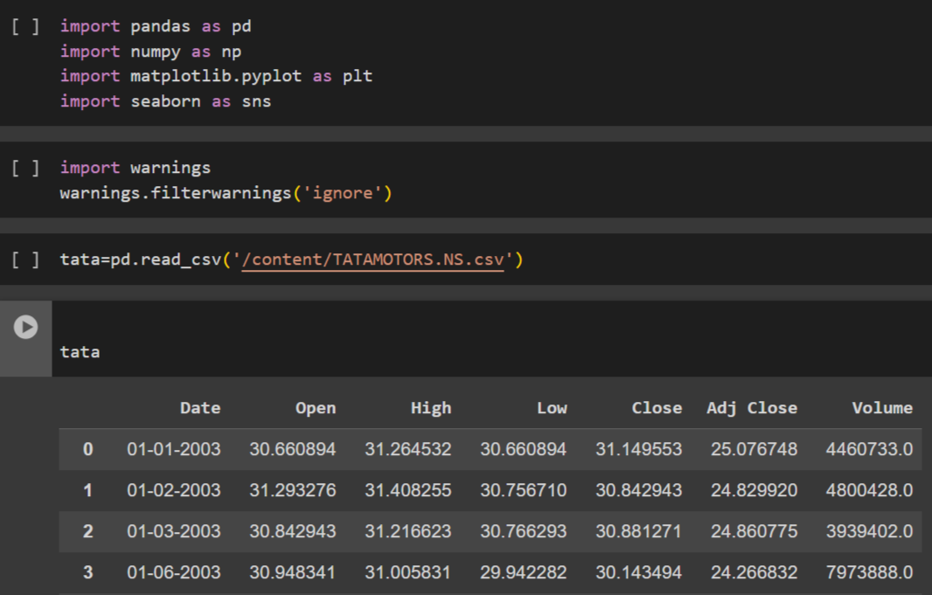
Importing the Data
Importing Necessary Libraries to read the data.
Importing Warnings to ignore the warning

Slide 11
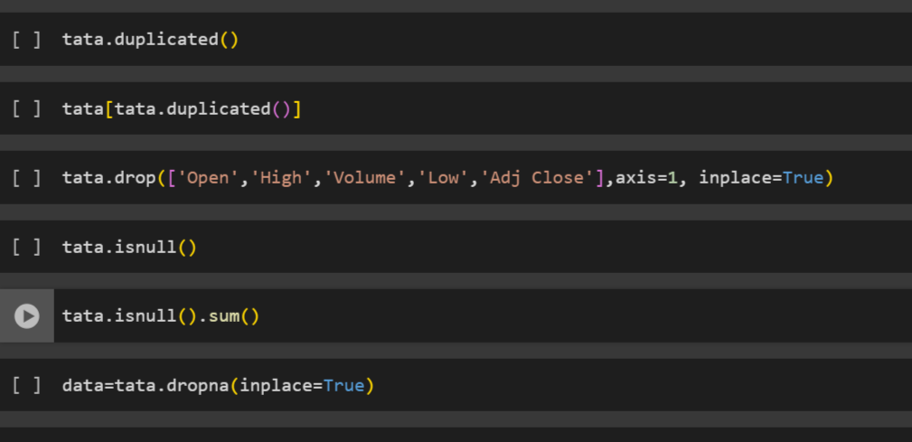
Data Cleaning
Checking Duplicates.
Dropping Unnecessary Columns
Checking Null Values
Removing All Null Values
Checking outliers using Boxplot

Slide 12
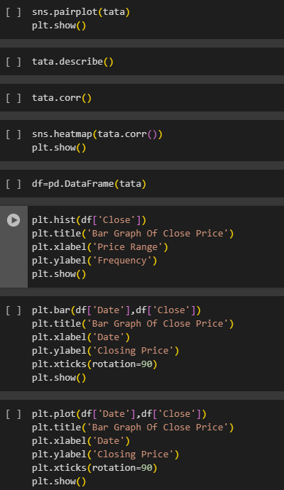
Data Visualization
Plotting Pair plot.
Checking the correlation.
Checking Frequency Using Bar Graph.
Bar plot for Date and Close column.

Slide 13
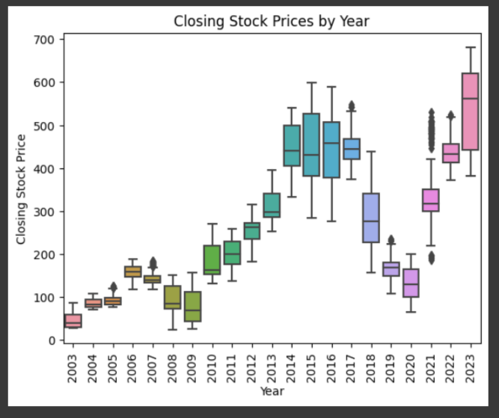
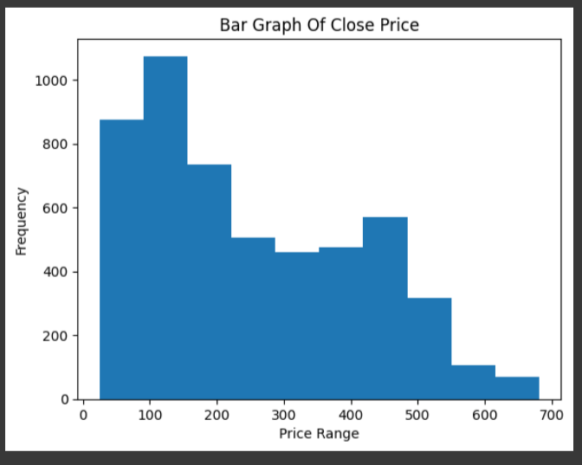
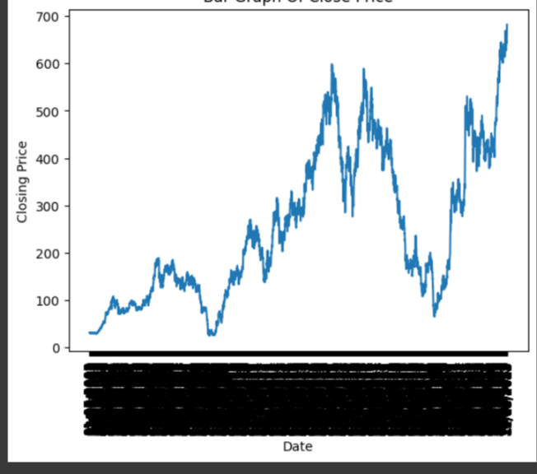
Visualization Using Different Graphs

Slide 14
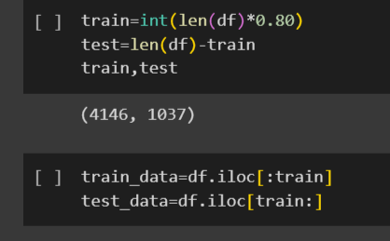
Dividing Data Into Train And Test
First 80% Data to Drain Data
Other 20% Data for Test Data
We will not divide data randomly

Slide 15

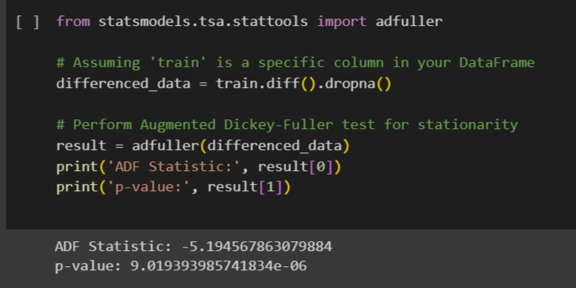
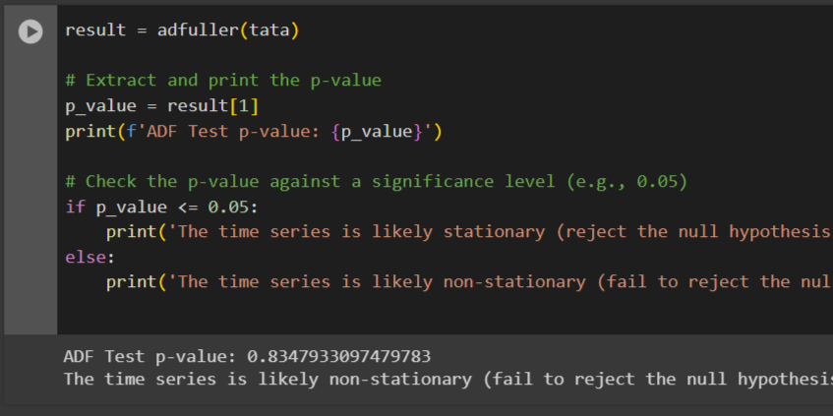
Making Data Stationary
Checking P-Value
ADF test
Rolling Mean
Differencing (Lagging)
Autocorrelation (P)
Partial Autocorrelation (Q)

Slide 16
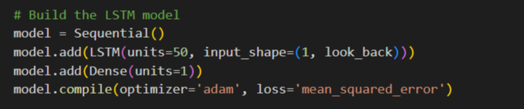
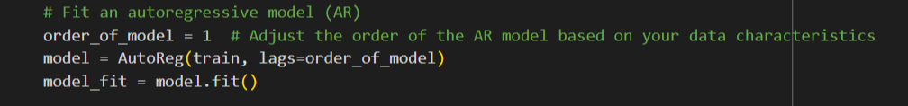
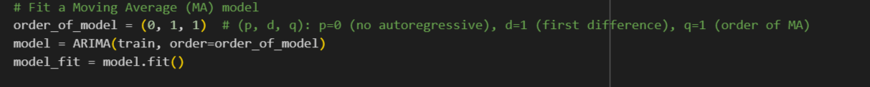
Model Building
There are five model :
Moving Average (MA)
Auto Regression (AR)
ARIMA
SARIMA
LSTM
We will be selecting best out of all five on the basis of least Mean Square value (MSE) and Root Mean Square value (RMSE)

Slide 17
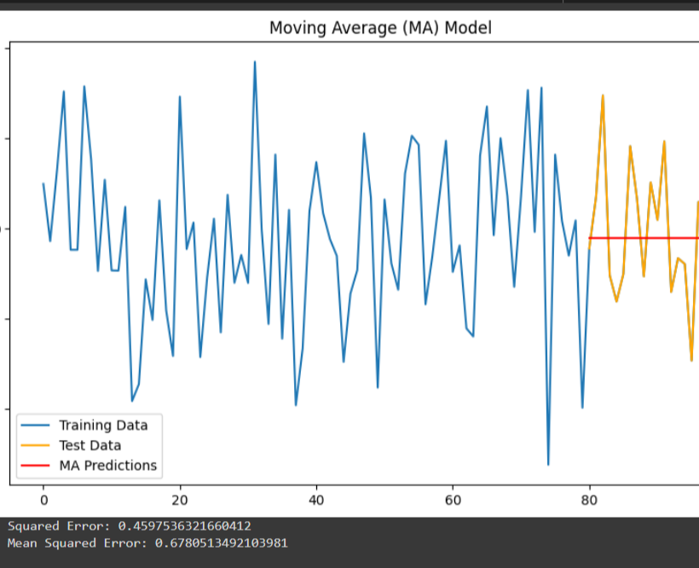
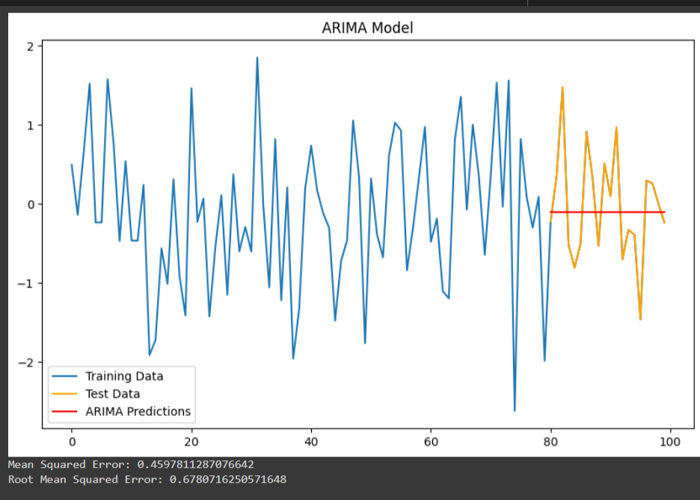
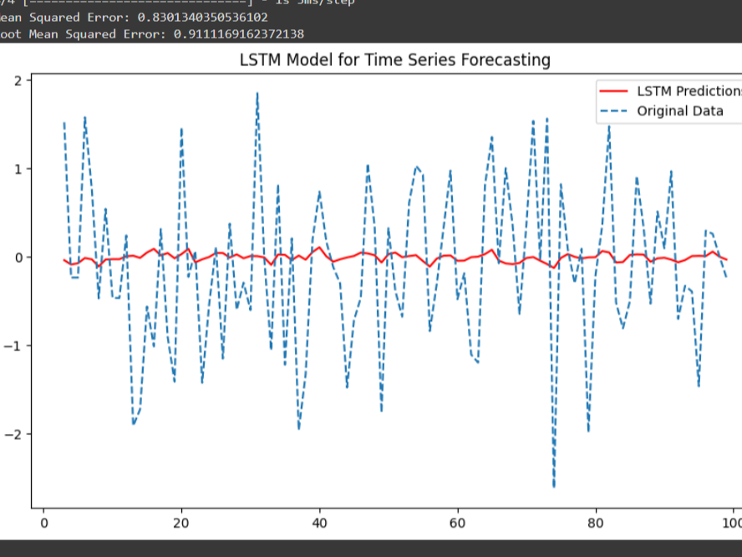
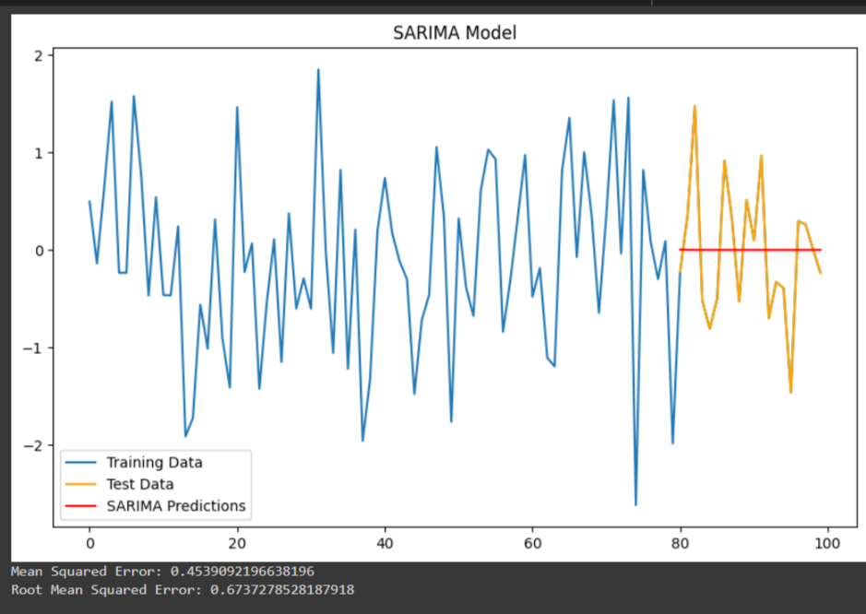
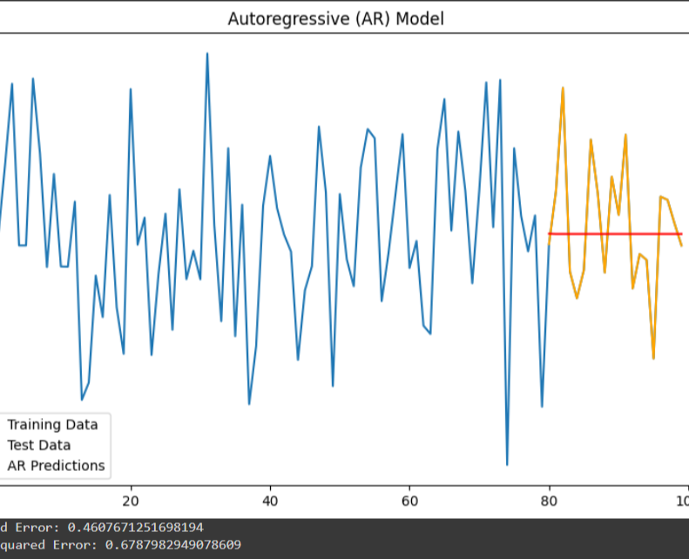
Graphical Comparision of all the model

Slide 18
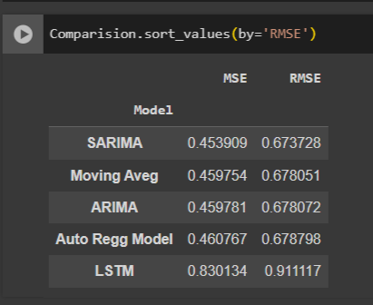
Comparing the results

Slide 19
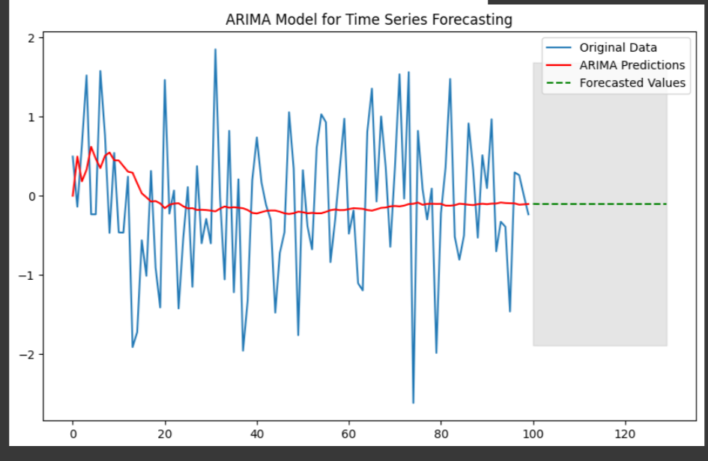
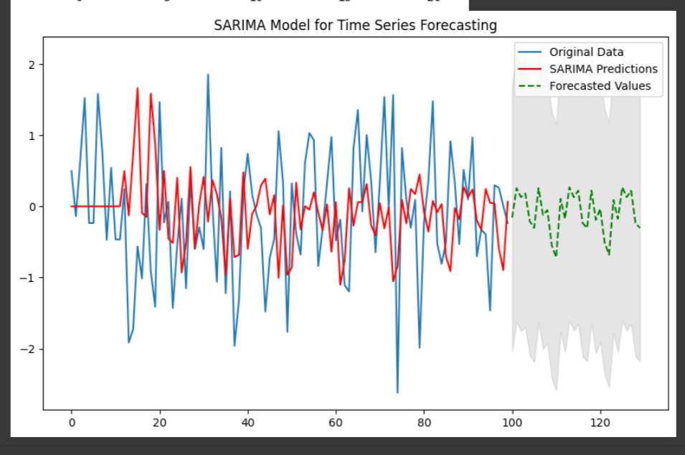
Comparing Result of forecasted Graphs of ARIMA and SARIMA

Slide 20
Conclusion
We train our model and then we test it. After testing we predicted for next 30 days.
Since there is very less difference between RMSE and MSE of all the five model, So we will be selecting the SARIMA model for the deployment. Since it giving the best results.
We are forecasting the for the next 30 days and we can see that the SARIMA graph gives better prediction than ARIMA and LSTM

Slide 21

Thank You

